Slide 1
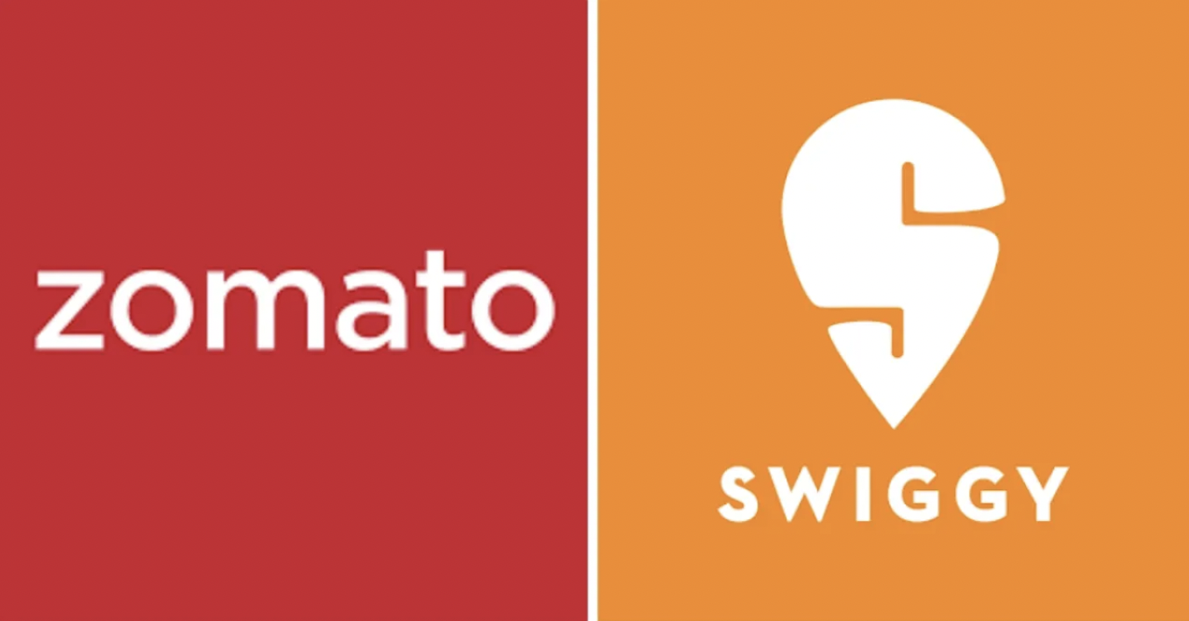
Online Delivery Restaurants Project Vaibhav Prakash Gupta 19 Dec 2023

Slide 2

Introduction and Problem Statment
Market Research
Target Countries
Competitors in the Market
Cuisine Adaptation
Financial Projections
Marketing Strategy
Competitor in the Market
Dashboard
Conclusion and key Insights

Slide 3

Introduction with Problem Statement
Zomato team wants to expand own business, opening new restaurants in different country to capture the maximum customers of different prize range and cuisines according to country.
A dataset of food industry(restaurants) is Analysed and insights & information is derived from the data .
Purpose of the study is to initially analyse the data and draw certain information from it .

Slide 4
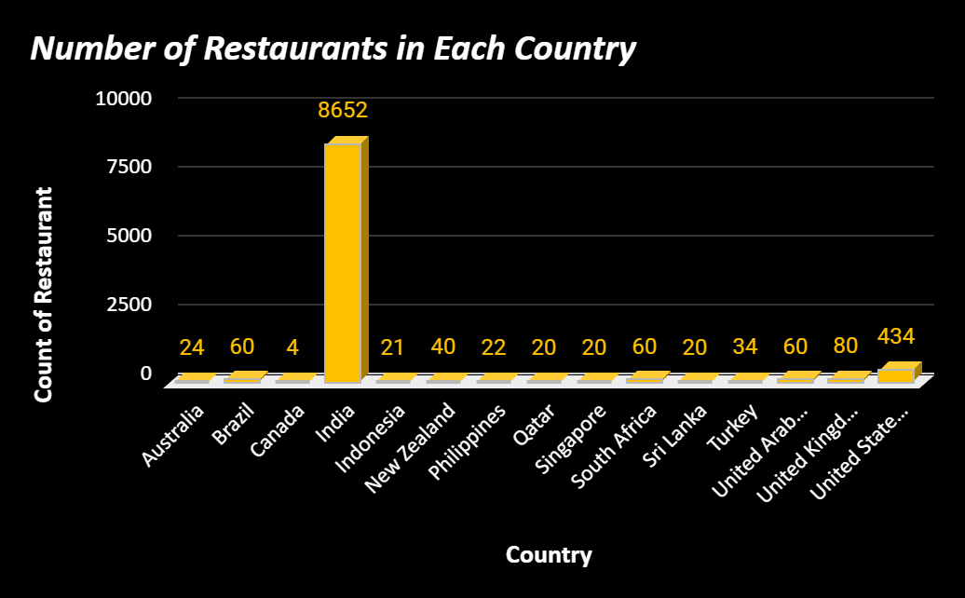
Market Research
Total Country -15
In all over world there are 9551 restaurants.
Total Number of Cuisines 1826.
Highest Number of Restaurants seen in India-8652.
Lowest Number of Restaurants seen in Canada- 4
And 388 restaurants having above than Prize range 4 in India.

Slide 5
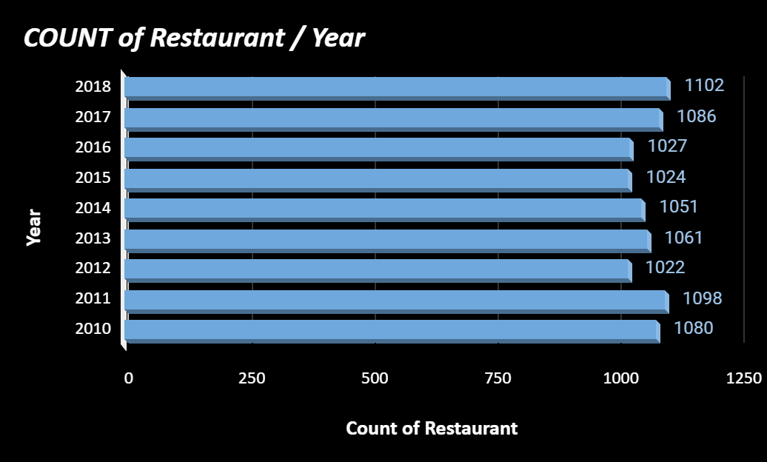
Market Research
1000
According to our data, Every year more than 1000 restaurants are open all over the country from 2010 to 2018.
1027
In Year 2012 had the lowest openings of restaurants
1102
In Year 2018 had the highest opening of restaurants
2010
In 2010, 2011 has good number of opening restaurants.
2012–2016
There was a slowdown in openings

Slide 6
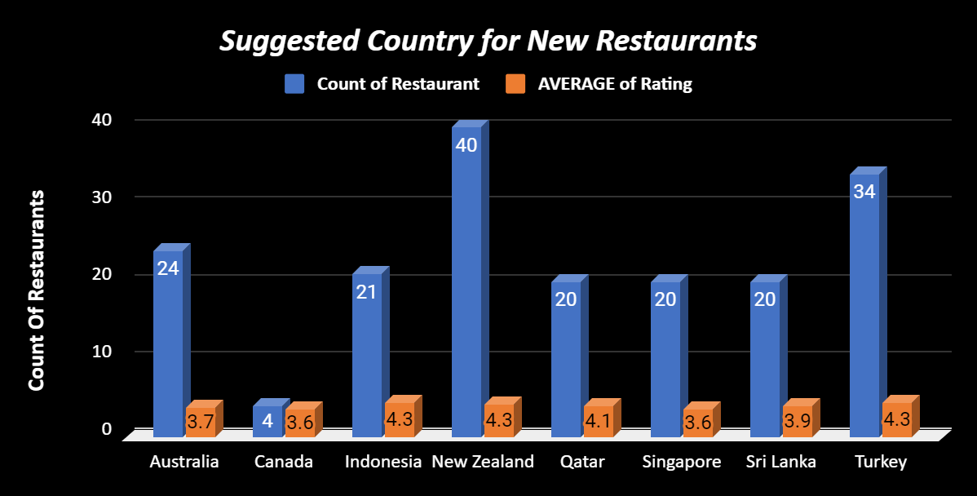
TARGET COUNTRY
According to our analysis we find some country there less than 40 restaurants are opened and average rating below than 4.5.
Canada have only 4 restaurants and have only 3.6 average rating this is best country to expend business.
Qatar, Singapore, Sri Lanka have 20 restaurants with good rating, so these country have our next target.

Slide 7
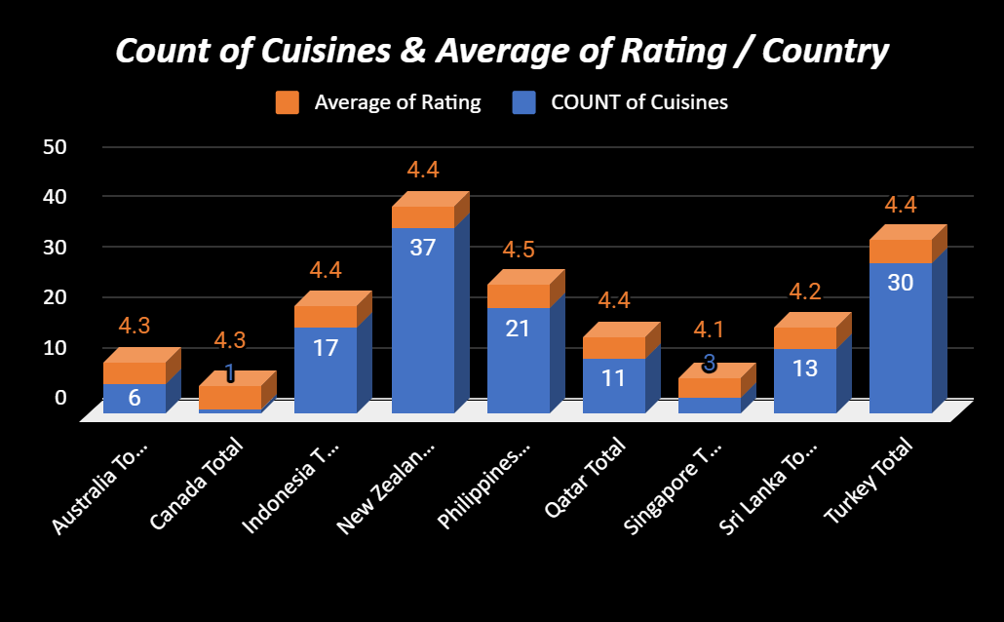
Cuisine Adaptation
On basis of our data, we can suggest only those cuisines which have greater than 4 rating in the suggested country.
We only suggest those cuisines which have more than 4 average rating.
We also suggest number of cuisines country wise.
Maximum number of cuisines suggested in New Zealand that is 37 and the average of cuisines is 4.4.

Slide 8
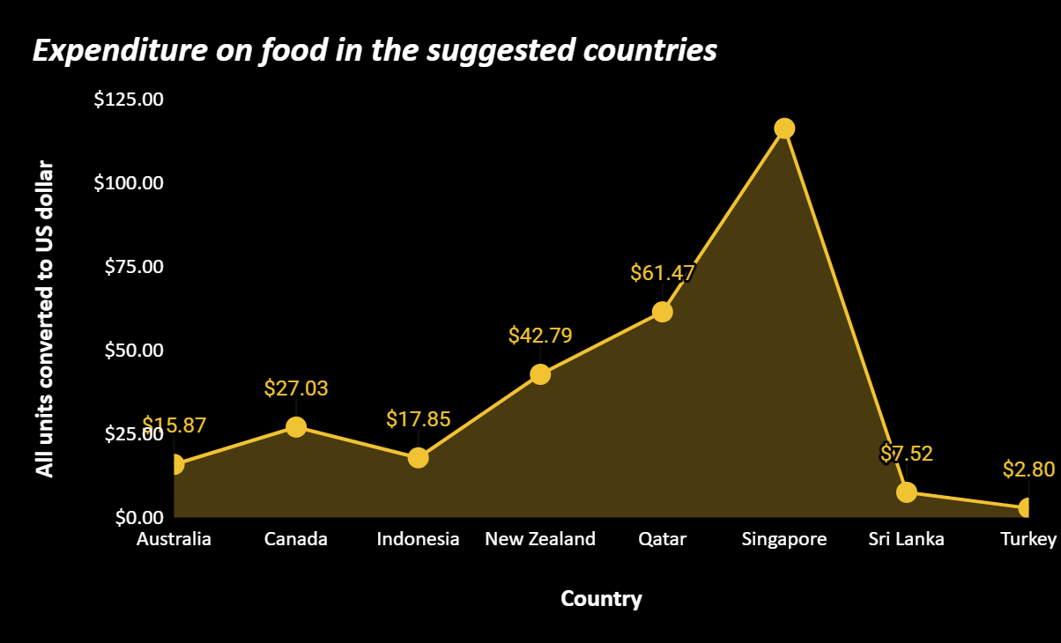
Financial Projections
On the basis of our analysis, we can control the expenditure on food to know the average prize of two people spent on food.
We convert the all the country currency in US Doller.
In Singapore we need to spend $116.34 as average money for two people.
In Turkey people need to spend $2.80 per two personal
So, we can serve the food under that budget.
Country | Currency
Australia | Dollar($)
Canada | Dollar($)
Indonesia | Indonesian Rupiah(IDR)
New Zealand | Dollar($)
Philippines | Botswana Pula(P)
Qatar | Qatari Rial(QR)
Singapore | Dollar($)
Sri Lanka | Sri Lankan Rupee(LKR)
Turkey | Turkish lira

Slide 9
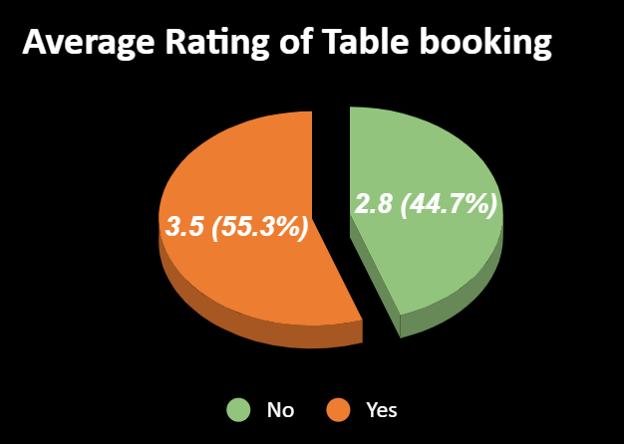
Marketing Strategy
Newer restaurants also offers the table booking option because the table booking affects the rating.
Average rating of table booking is 3.5 (55.3%).
Average rating of not booking table is 2.8 (44.7%)
So, People wants table booking system in new restaurants and the rating is also higher.
It can be Concluded – Table bookings should be offered and has direct relationship with ratings.

Slide 10
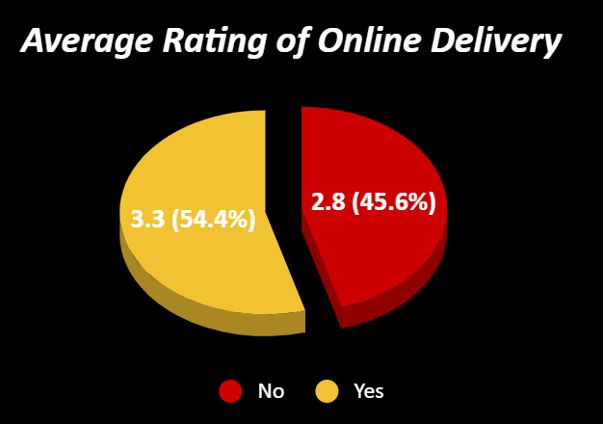
Marketing Strategy
We can also provide online delivery option because it also affects the rating of restaurants.
Average rating of Online delivery is 3.5 (54.4%).
Average rating of not having online delivery is 2.8 (45.6%)
So, People wants table booking system in new restaurants and the rating is also higher.
It can be Concluded – Table bookings and Online delivery should be offered and has direct relationship with ratings.

Slide 11
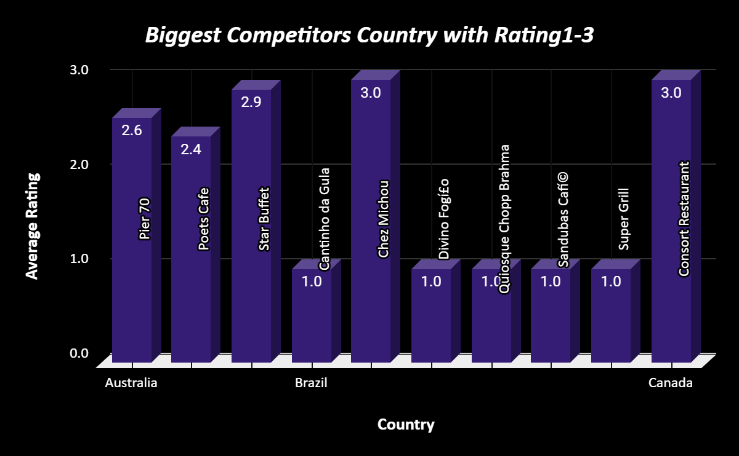
Competition in the Market
There are some Country here which will provide a lot of competition in the market.
India is biggest competitor in the market because 116 restaurants having grater than 4.5 rating.
India and Singapore both are biggest competitor in market those are average rating between 1-3.
As per our data 8652 restaurants are in India and 4027 restaurants are below than 3 rating.

Slide 12
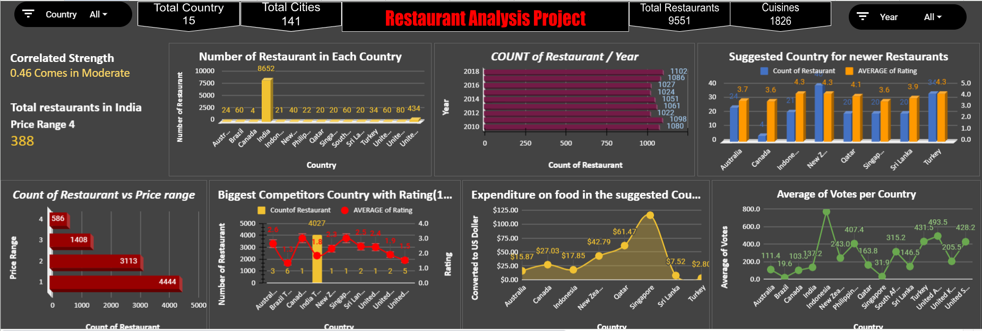
Dashboard

Slide 13

Conclusion & key insights for further actions
CANADA ,QUATAR ,SRI-LANKA,PHILLIPINES ,INDONESIA ,AUSTRALIA are the potential opportunities where the management can look upon to invest. As well India can be looked upon but utmost strategy with quality concerns should exist to plan a restaurant to surpass other’s competition.
Services and quality in terms of food ,ambience, taste is more important compared to strategizing on cuisine type.
Online food delivery & table booking services has a direct effect on ratings of a restaurant.
For price range, by a good strategy if in a moderate price range if good services are provided still the restaurant can be profitable.

Slide 14


